Slide 1
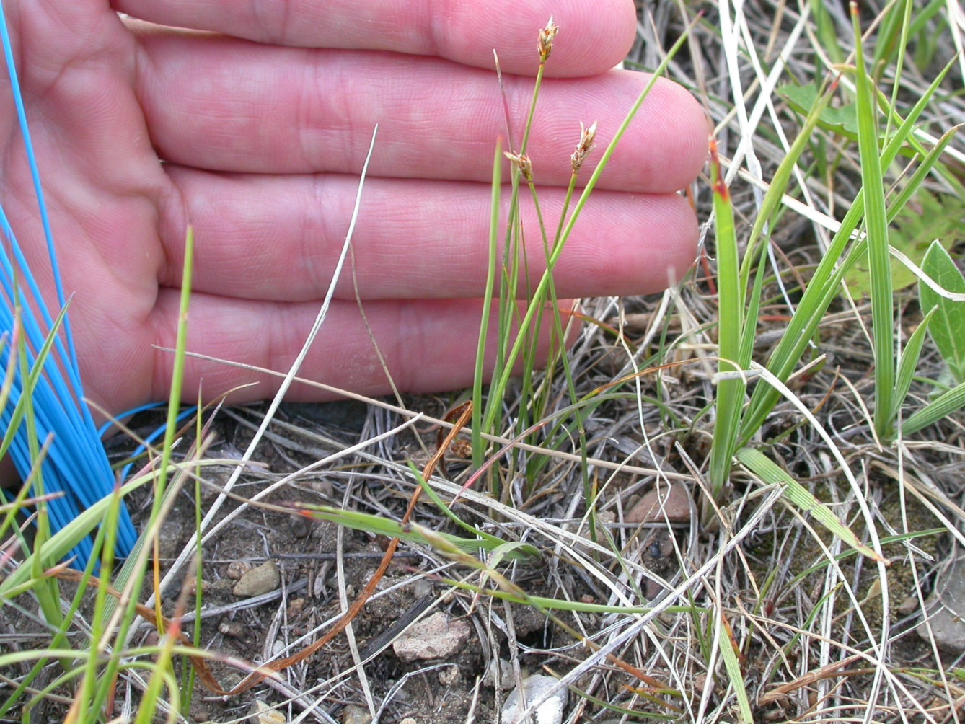
CADU Carex duriuscola
C3-PG
needleleaf sedge

Slide 2
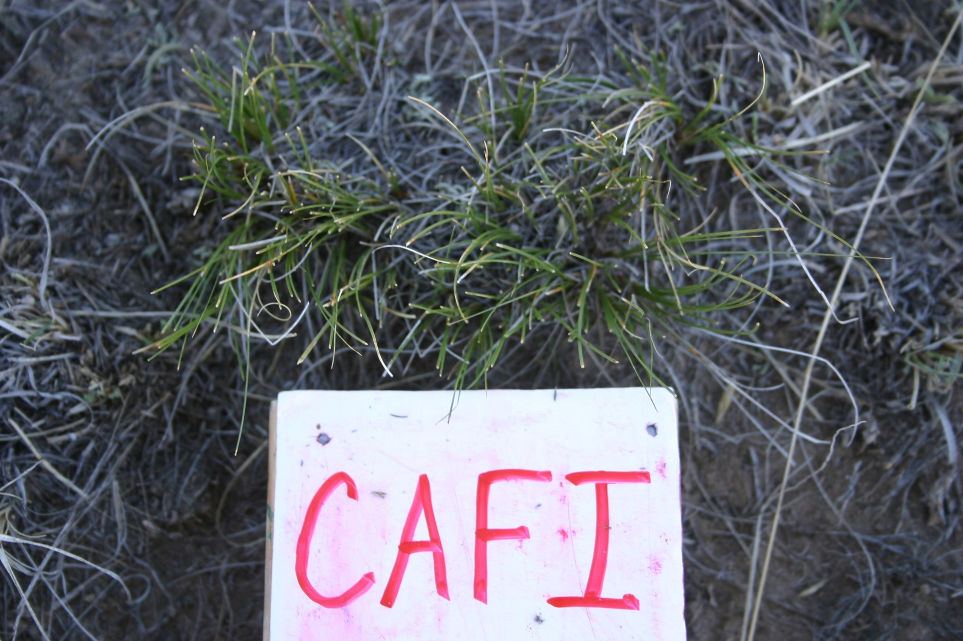
C3-PG
Carex filifolia
threadleaf sedge
Notes:
Looks similar to CAEL but it is a bunch grass

Slide 3
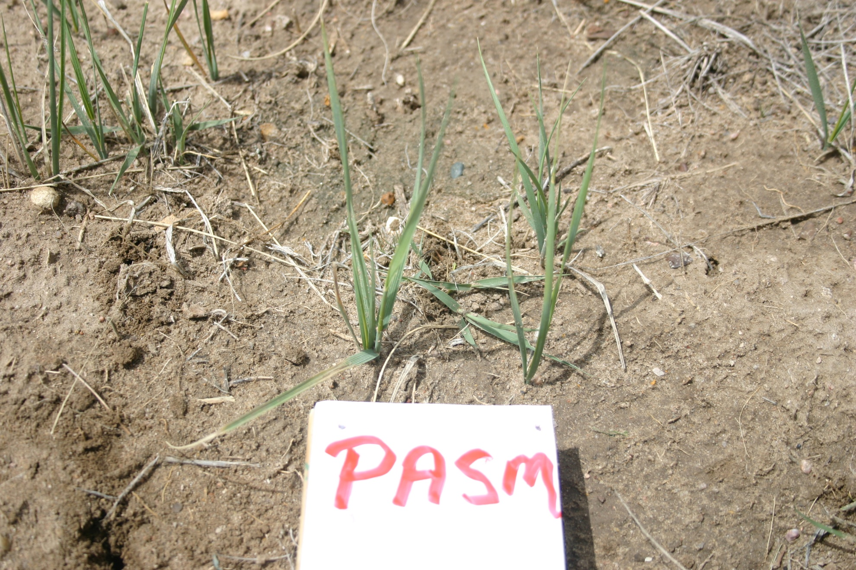
C3-PG
Pascopyron smithii
Western wheatgrass

Slide 4
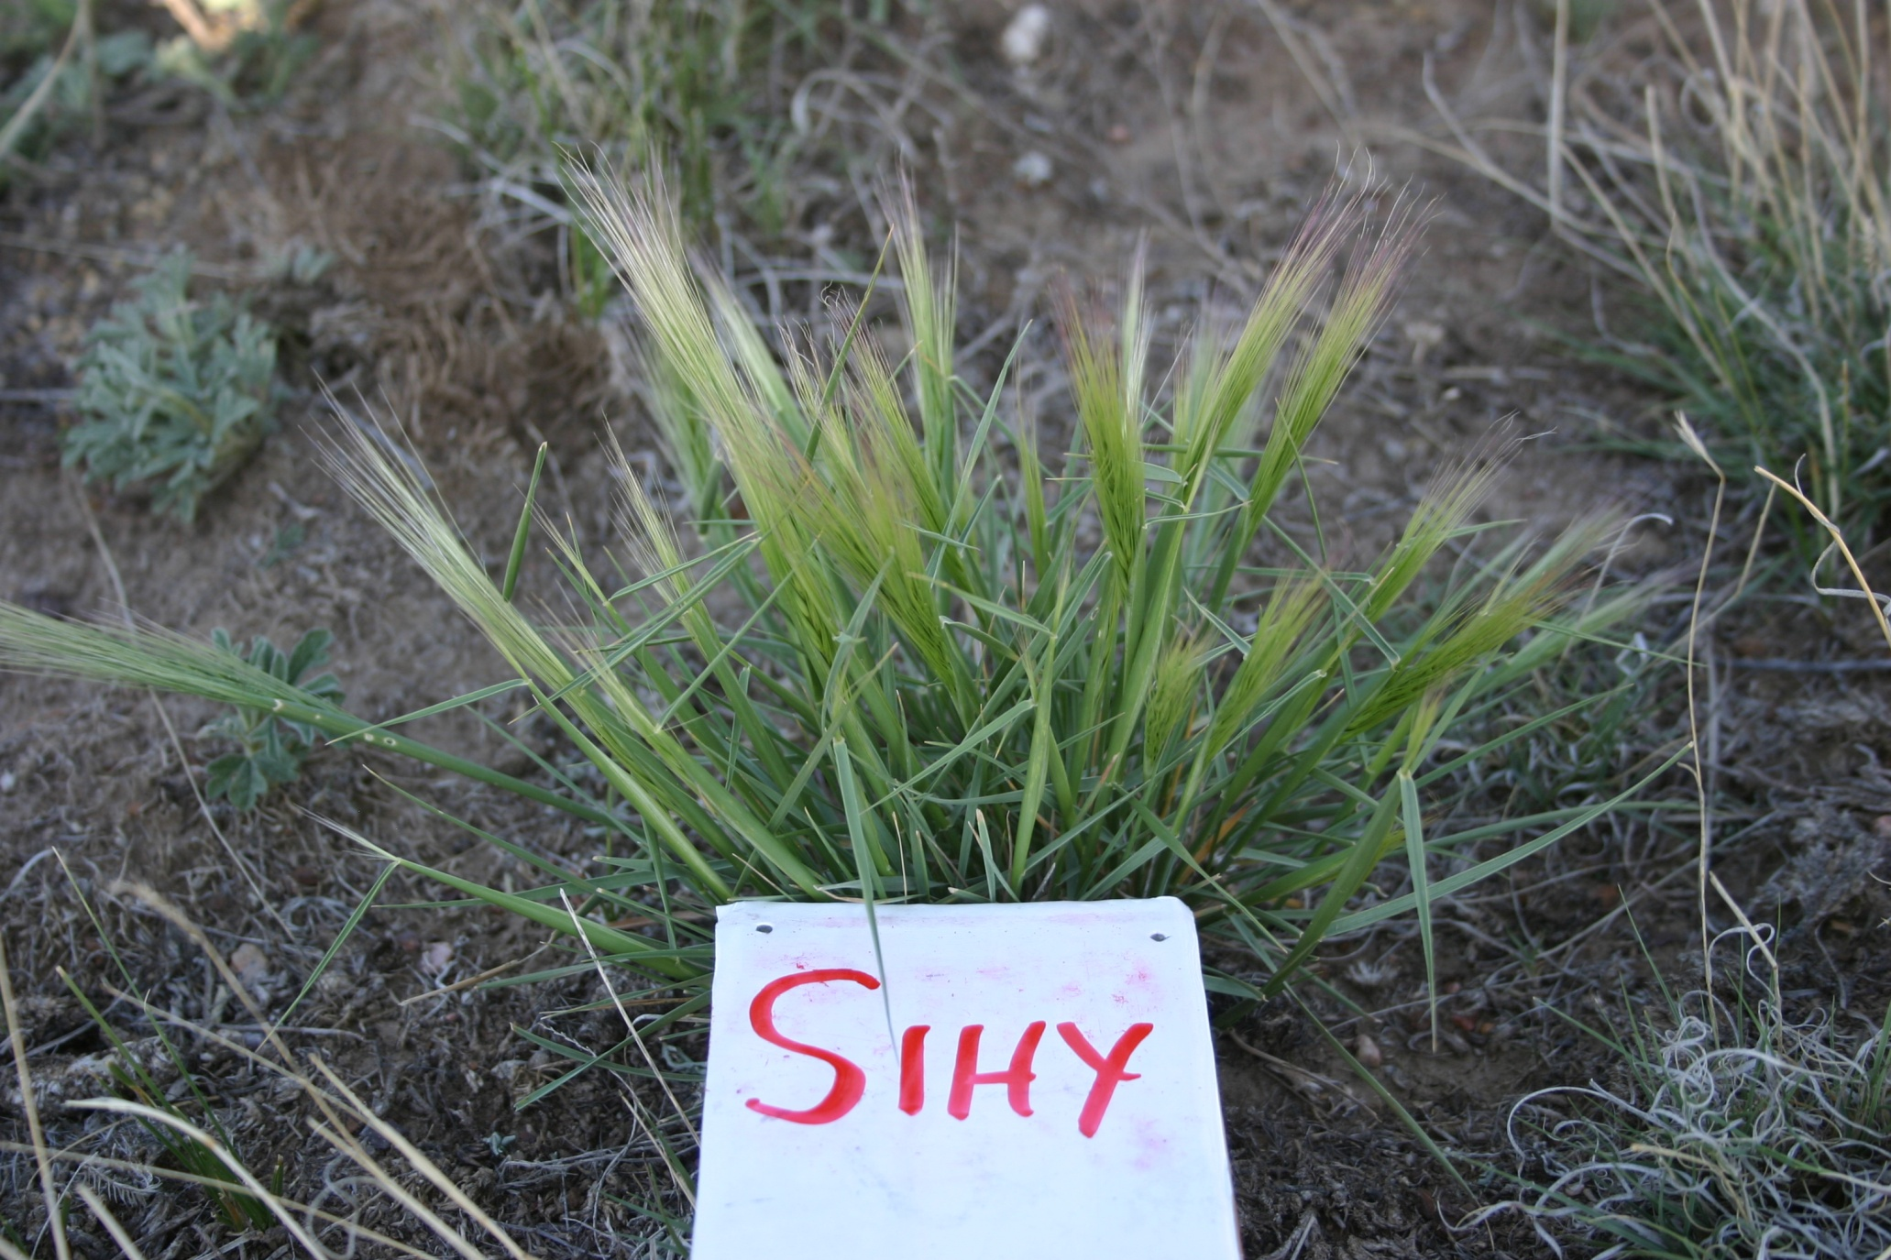
C3-PG
Elymus elymoides
squirreltail bottlebrush
ELEL

Slide 5
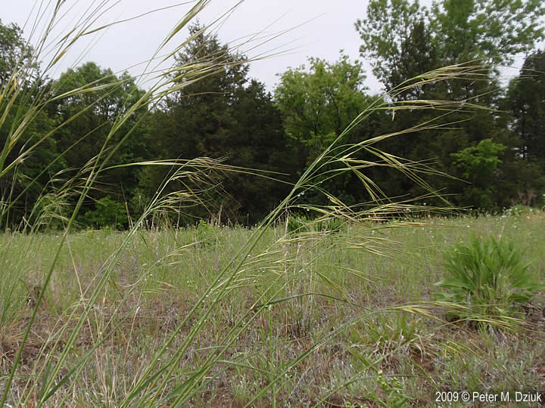
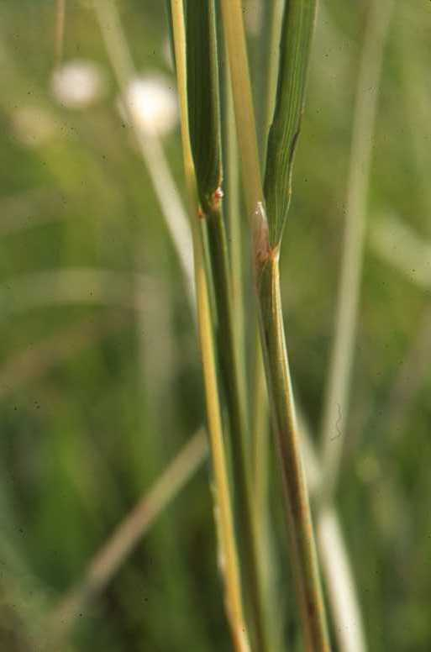
C3-PG
Hesperostipa comata
Needle and Thread
Papery ligule
HECO

Slide 6
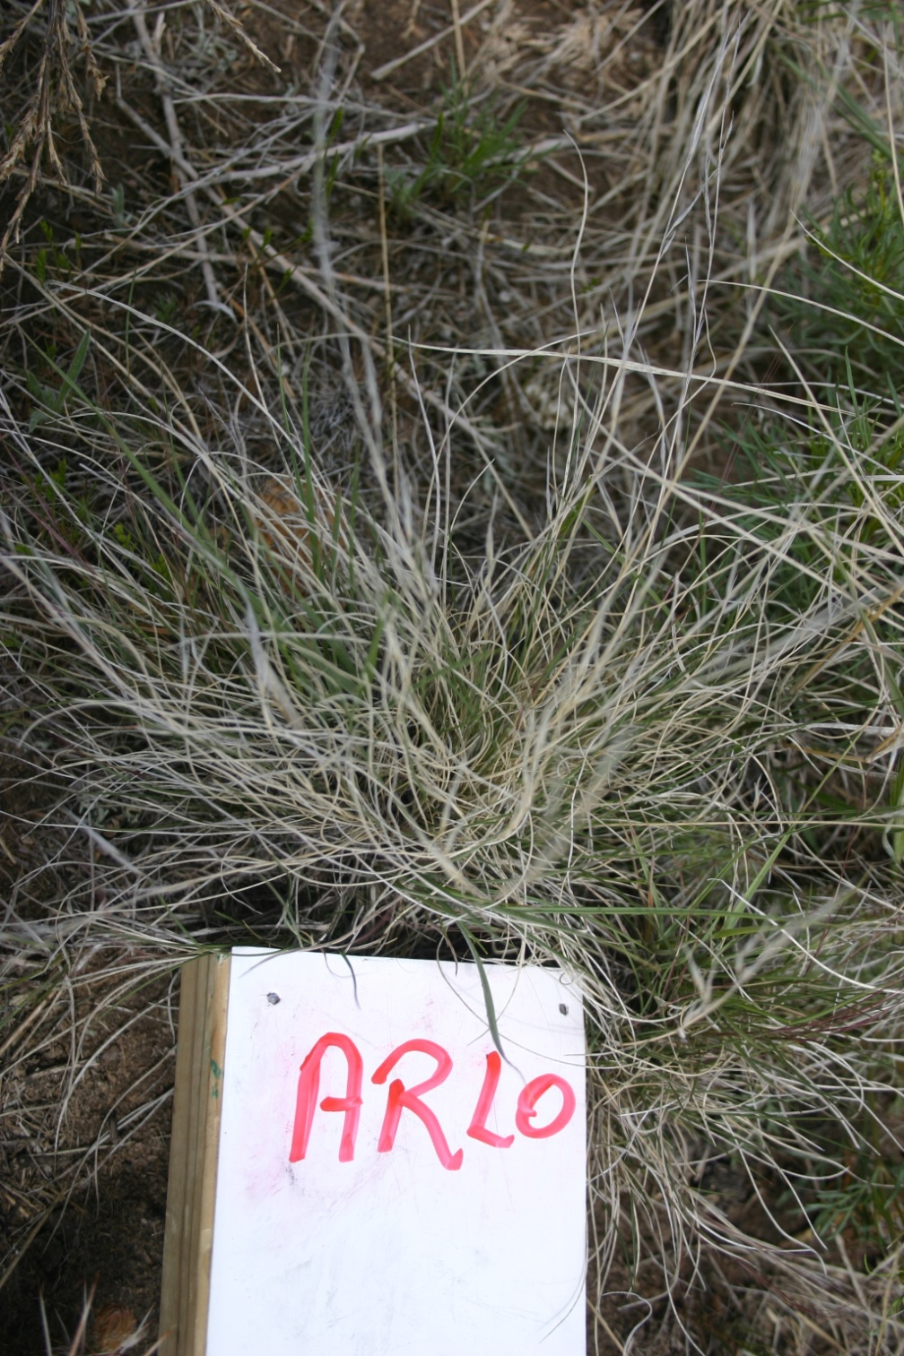
C4-PG
Aristida purpurea
Purple three-awn
ARPU

Slide 7
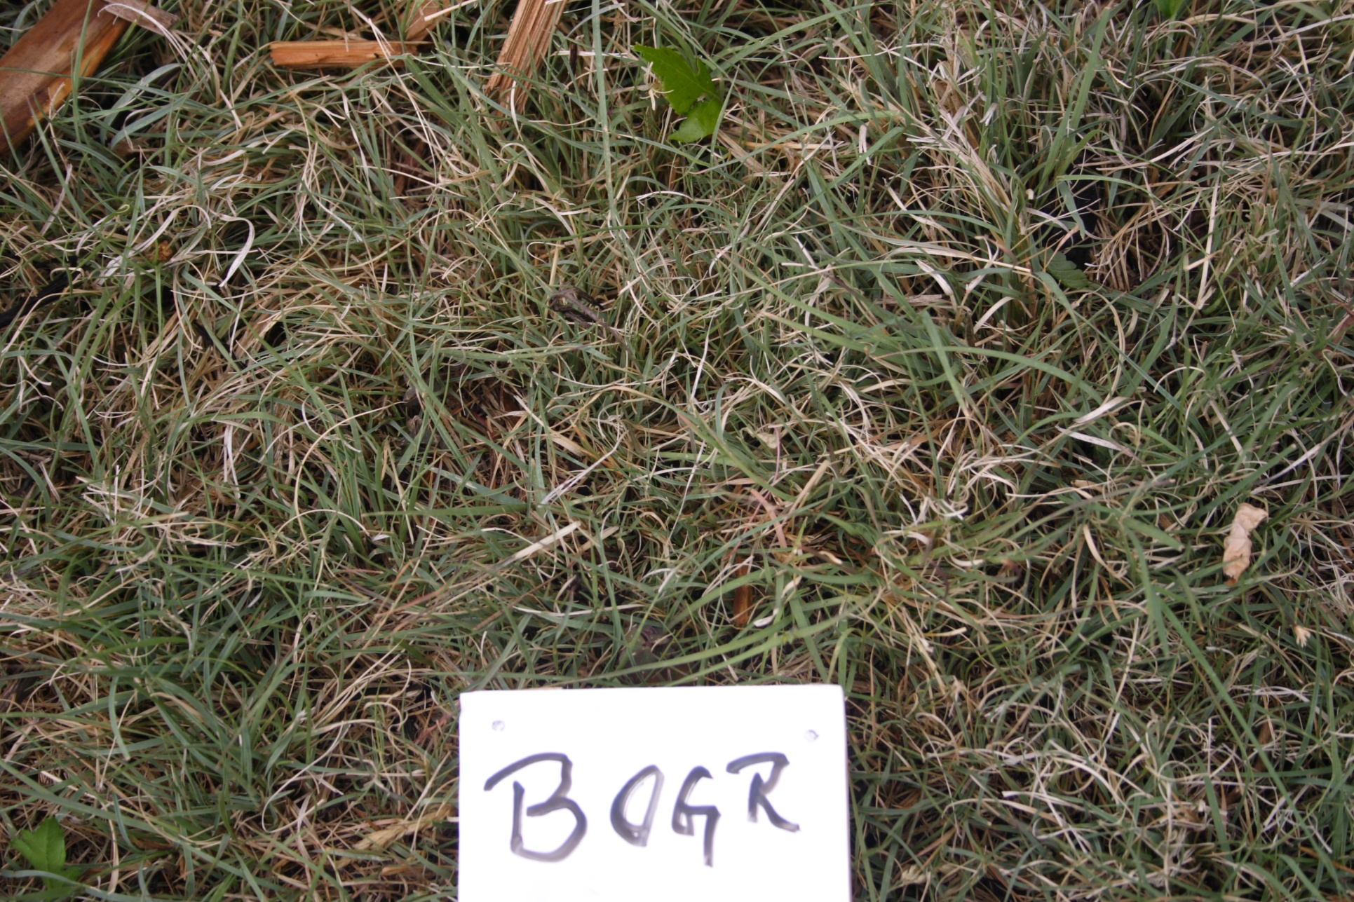
C4-PG
Bouteloua gracilis
Blue grama

Slide 8
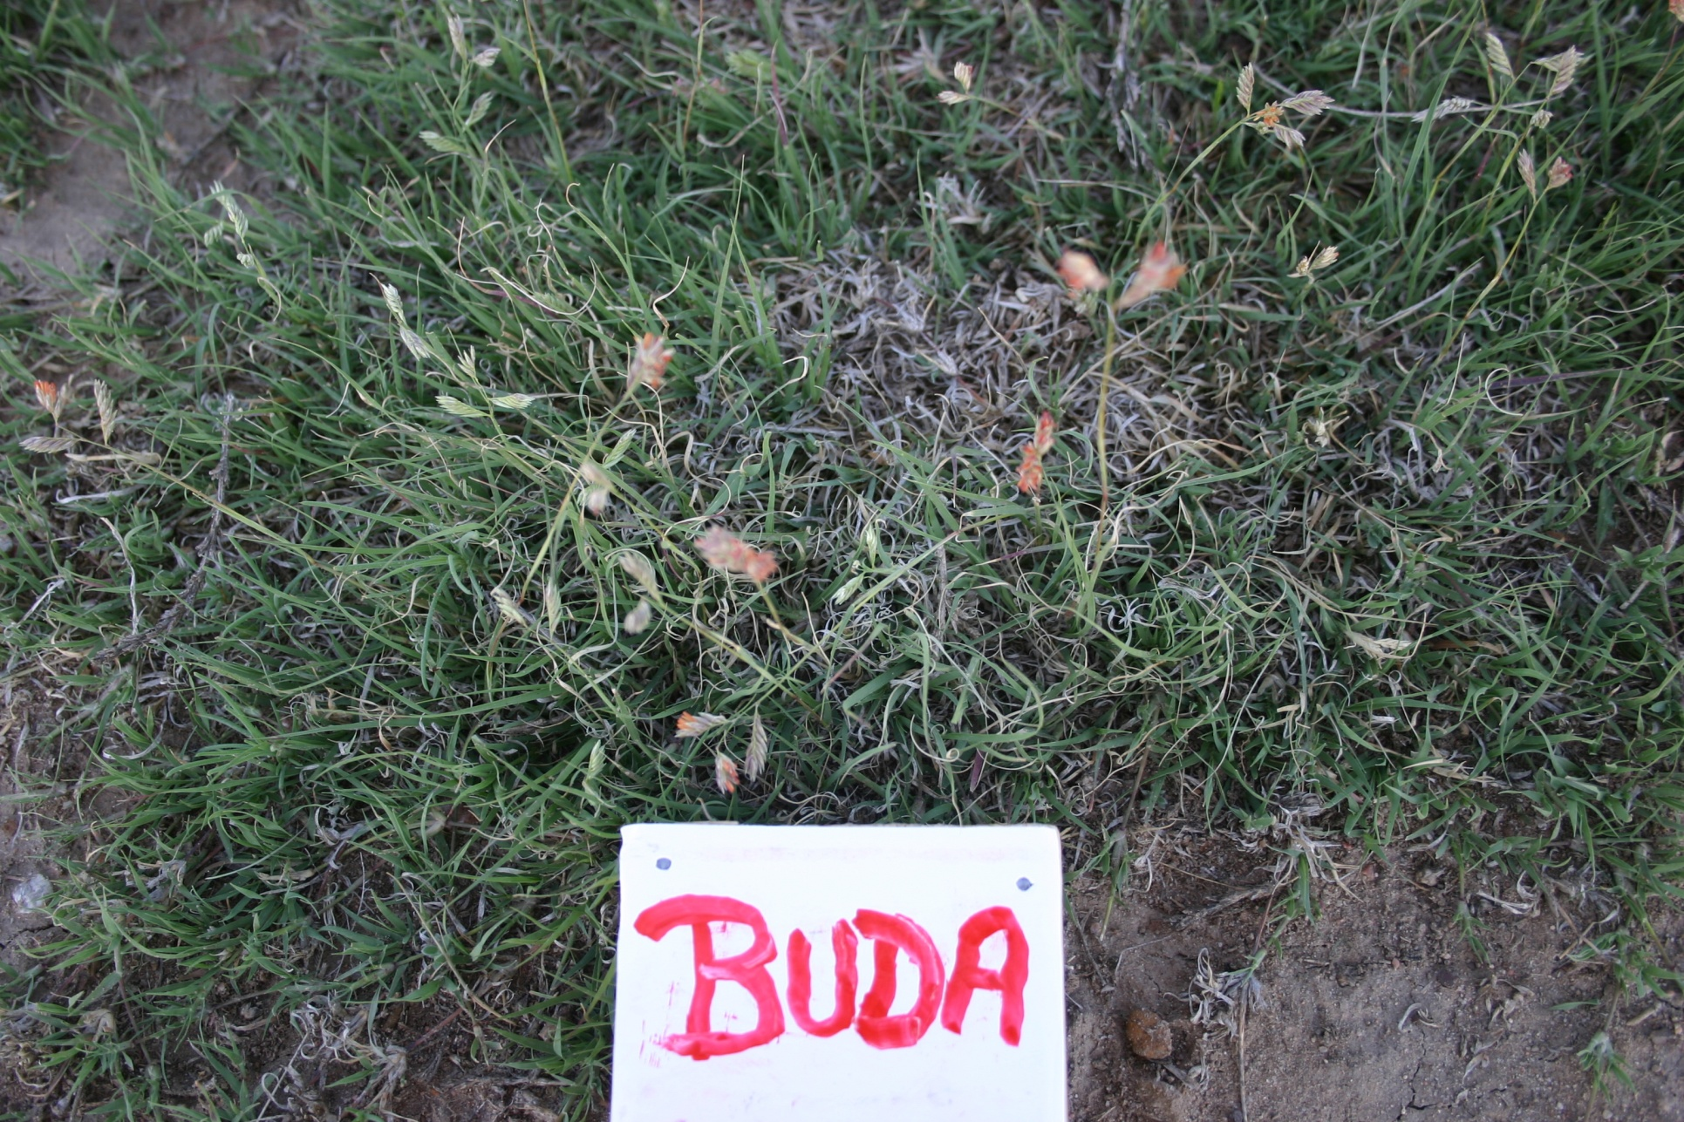
C4-PG
Buchloe dactyloides
buffalograss

Slide 9
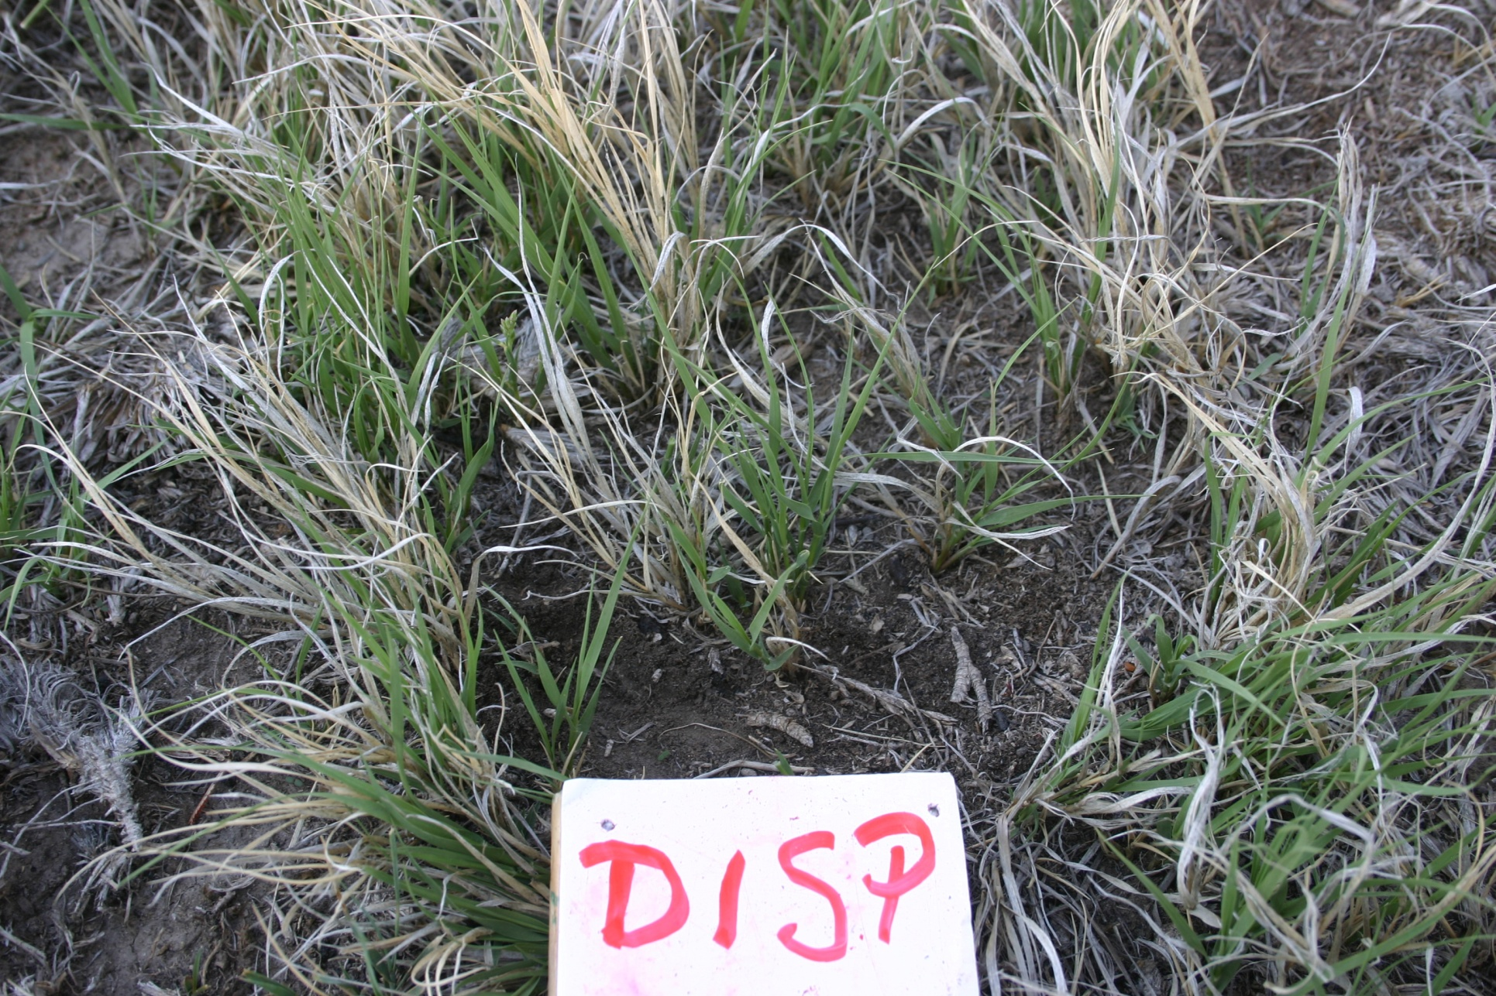
C4-PG
Distichlis spicata
inland saltgrass
Notes:
Found mainly in salt flats

Slide 10
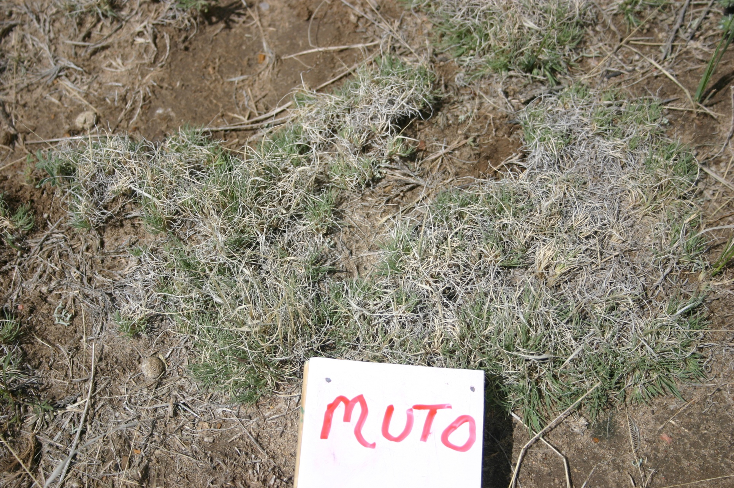
C4-PG
Muhlenbergia torreyi
ring muhly

Slide 11
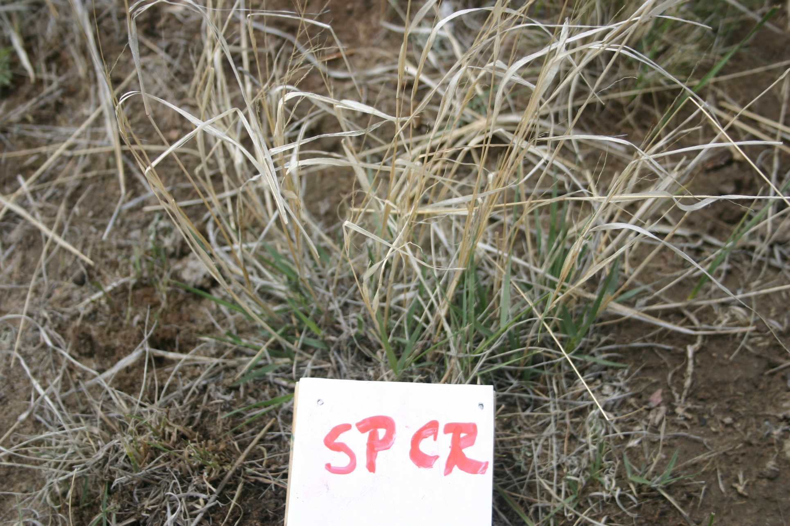
C4-PG
Sporobolus cryptandrus
sand dropseed
Notes:
The leaves look like flags waving in the wind once they have browned (like in photo above)
Not very noticeable otherwise, and can be blended in well with BOGR

Slide 12
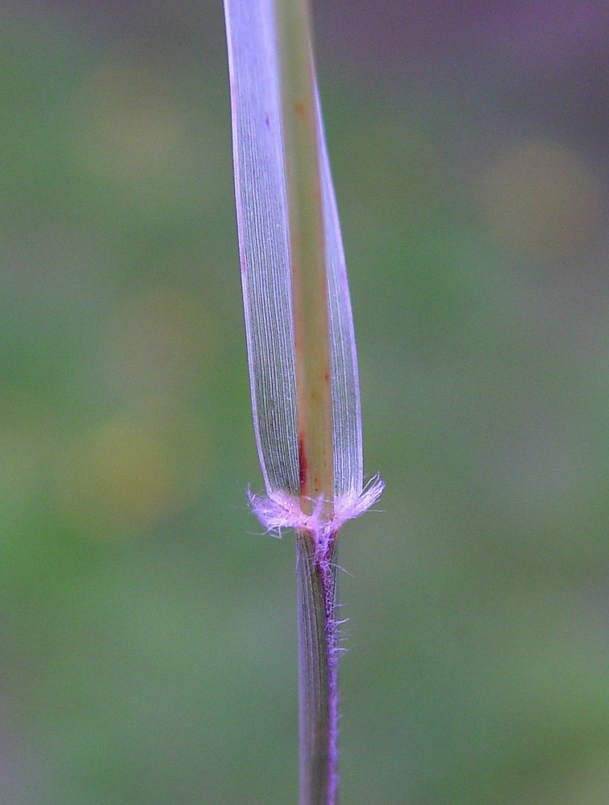
C4-PG
Sporobolus cryptandrus
Pubescent auricle
Notes:
The leaves look like flags waving in the wind once they have browned (like in photo above)
Not very noticeable otherwise, and can be blended in well with BOGR

Slide 13
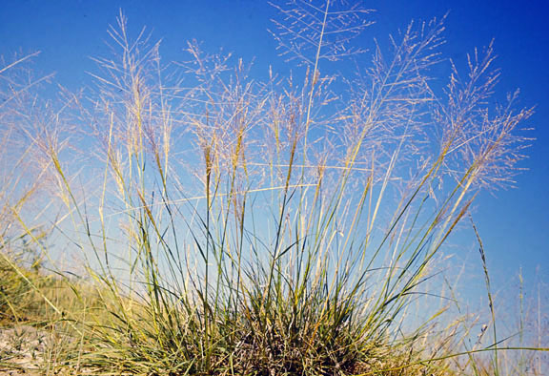
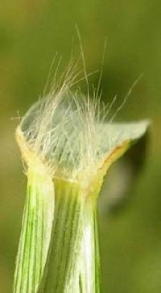
C4-PG
Sporobolus airoides
alkali sacaton
Hairy auricle
Notes:
Same family as SPCR, similar inflorescence. SPAI is a larger bunchgrass found in the salt flats.

Slide 14
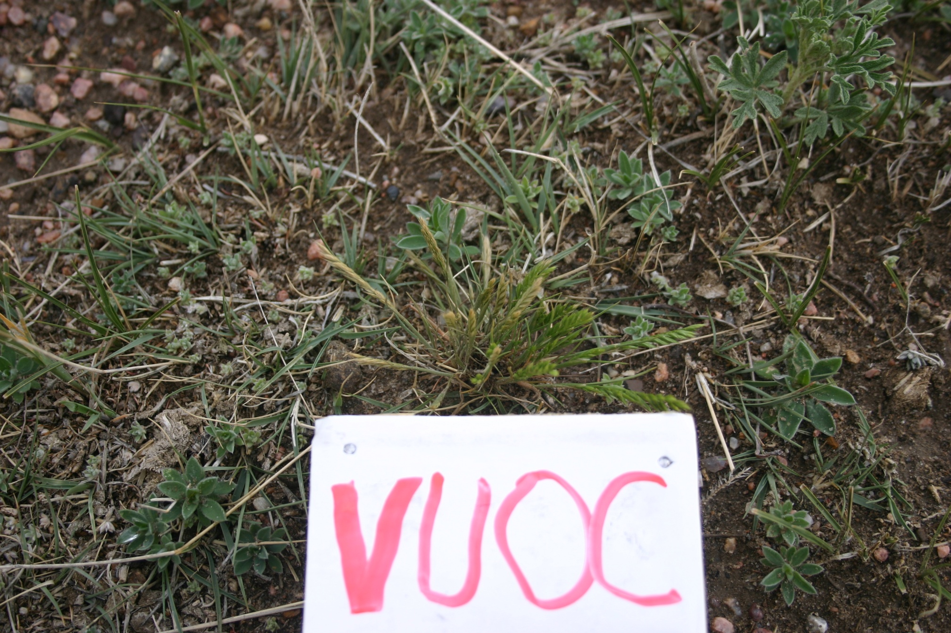
ANNUAL (C3)
Vulpia octoflora
sixweeks fescue

Slide 15
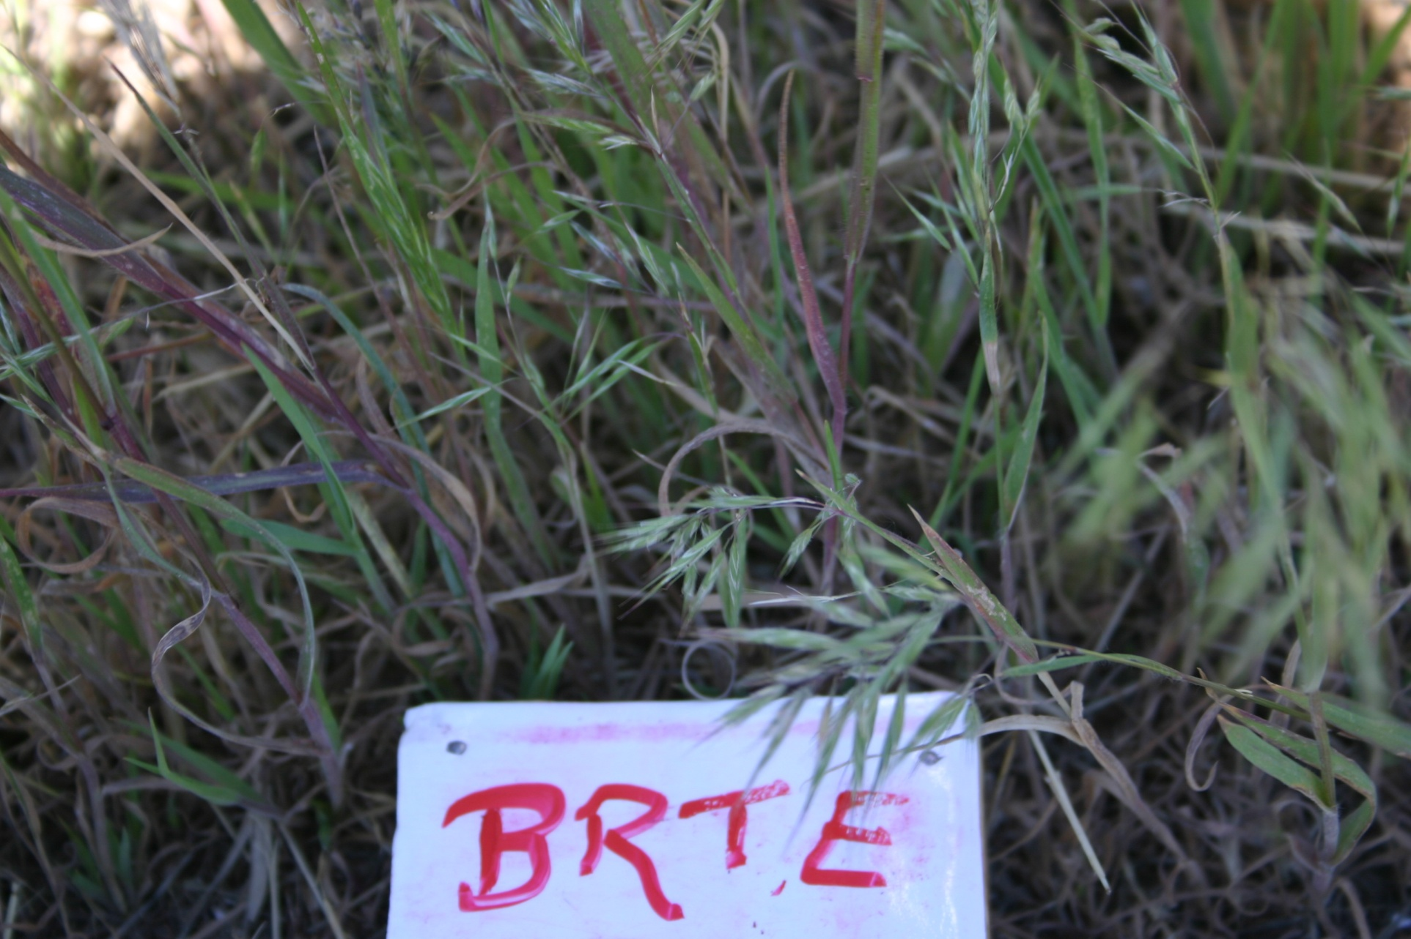
ANNUAL (C3)
Bromus tectorum
cheatgrass

